Slide 1
Track-While-Scan
(TWS)
Notes:
Everyone signed for books?
Marine Options - This class may be optional for you.

Slide 2
Objectives
Comprehend concepts of TWS system
Know the basic functions of a TWS system
modeling and simulation of TWS Radar system based on GNN data association Algorithm and Linear Kalman filter

Slide 3
Problems
Dedicated fire control (FC) radar can only track one target.
Systems usually have separate Scanning and Tracking Radars.
The target knows it’s being tracked.
The target can initiate Counter Measures
Notes:
EP = Electronic Protection
EA = Electronic Attack
[ ...and then ES = Electronic Support ]

Slide 4
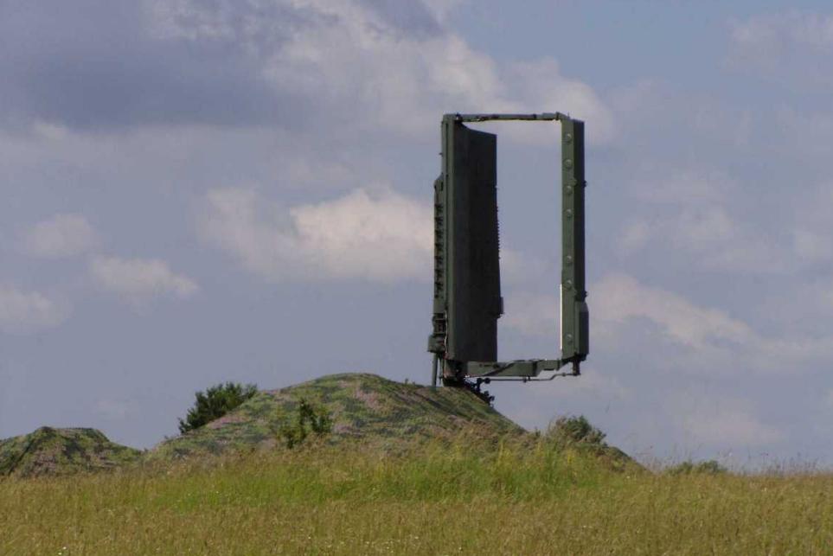
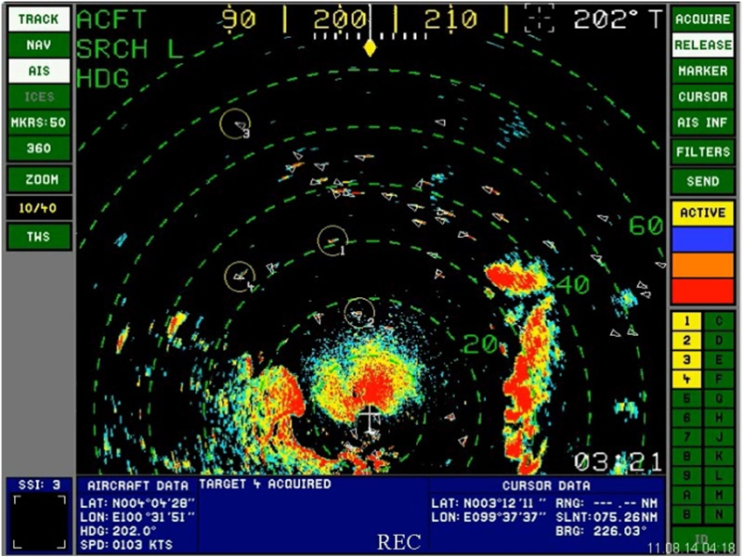
Concept of TWS
Maintain Target tracks in a computer
Periodic updates from a scanning radar
ST68UM „36D6”
Notes:
1. Maintain target tracks in a computer with periodic information updates from a scanning radar.
2. Get a search radar that can “help” solve fire control problems.
3. Sensor continues to perform primary function of search (scanning) and data input.
4. Computerization allows the system to perform a target tracking function.
5. Eliminates process of target designation from search radar to fire control radar.

Slide 5
Functions of TWS
Target detection
Target track correlation and association
Target track initiation and track file generation
(if no correlation)
Generation of tracking "gates“
Track gate prediction, smoothing (filtering), and positioning
Display and future target position calculation

Slide 6
Detection
Takes the scanning radar output, does analysis of the information and determines if the returns are from a target or just random noise.

Slide 7
Predict future target position
Uses information to predict mathematically where the target will be. Eliminates the feedback problem of always lagging the target.
The method of predicting the next scan track data is the Kalman filter.

Slide 8
Correlation
The track updating process typically begins with a procedure that is used to choose the best observation to track association. This procedure is known as data correlation and is conventionally comprised of two steps called gating and association.
most data association methods utilize gating in order to reduce later computation.
The use of Kalman filtering, with the associated covariance matrix, is assumed.
In a dense target environment additional logic is required when an observation falls within the gates of multiple target tracks or when multiple observations fall within the gate of a target track.

Slide 9
Cnt…
the data association step is then carried out to complete the assignments and resolve ambiguities.
The fames data association algorithm global nearest neighbor (GNN) handles this problem.

Slide 10
Track Initiation and file generation
(if a new target)
If it is a new target, the computer will start a file on that target. In the file it puts the position information on the target and will update the information with each subsequent scan.

Slide 11
Tracking “Gates”
Gating is a coarse test for eliminating unlikely observation-to-track pairing.
A gate is formed around the predicted position.
All measurements that satisfy the gating relationship fall within the gate are generated a cost matrix and are considered for track update.

Slide 12
Gate prediction, smoothing and positioning
tracking errors were generated as a result of the target moving off the antenna axis.
tracking errors also exist due to target motion.
The tracking gate now has replaced the "tracking antenna," and this gate must be positioned dynamically on the target.
This repositioning and smoothing must be done mathematically within the TWS algorithm.
To this end, smoothing and prediction equations are employed to calculate the changing position of the tracking window.
The classic method of smoothing track data is the Kalman filter.

Slide 13
TWS Diagram
Scanning radar
detects a target
Do
parameters match
those from previous
scan
Yes
Does
track ambiguity
exist
Yes
Resolve
ambiguity
NO
NO
Generate an
acquisition
gate
Generate a
new track file
& store data
Generate
Track Gate &
indicator in file
Compute
target tracking
parameters
Acquisition
Ready for the
next radar scan
information
Reposition track
gate centered on
future position
Target
previously in track
or acquisition
Recompute
track gate
Update
tracking
parameters
Track
Notes:
1. Track parameter storage, predicted track, gate determination, past history are all performed by computers which receive information from the scanning radar.
2. You can’t talk computers without a flow chart so here it is as a review.
Show slide. And explain what the tracking computers do.
- Show that this process can work for multiple contacts.

Slide 14
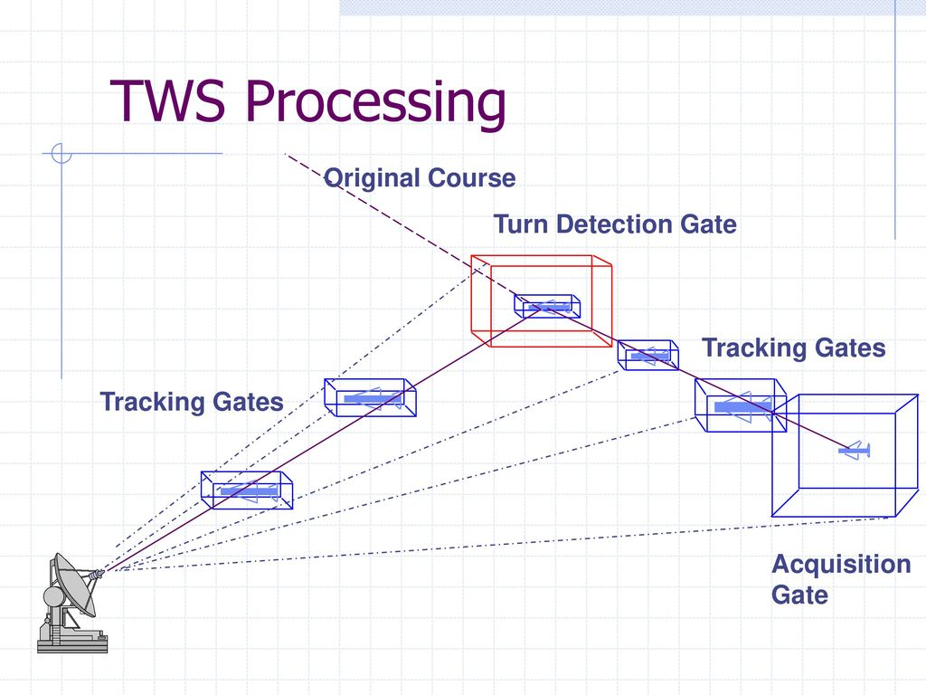
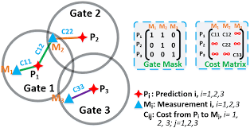

Slide 15
Pseudocode for Generating cost matrix
Step 1 :- Get all Parameters
getting(range, measurement, variance)
Step 2 :- initialize zeros of cost matrix
Step 3 :- check our measurement is in getting range
Step 4 :- if measurement is in getting range
Set measurement to cost matrix
Else
Set infinity to cost matrix
Step 5 :- go to step 3
Step 6 :- return ( cost matrix) for next step
end process

Slide 16
Munkers Assignment Algorithm
Step 1: Initially, no lines are covered and O's are starred or primed.
Step 2: Let v=min.(Number of rows, Number of columns}.
Step 3: If (number of rows) > (number of columns), go to Step 6.
Step 4: For each row in the matrix, subtract the smallest
element of the row from each element in the row.
Step 5: If the (number of columns) > (number of rows), go to Step 7
Step 6: For each column in the matrix, subtract the smallest
element of the column from each component of the
column and go to Step 7.
Step 7: a) Find a zero, "Z", of the matrix.
b) If there is no starred zero in its row or its column, star the
z row (i.e. Z*). Repeat for all zeros of the matrix. Go to Step 8.

Slide 17
Cont..
Step 8: a) Cover every column containing a starred zero Z*.
b) If v columns are covered, the locations of the Z* form the row-
column associations (i.e. observation-to-track pairs).
The algorithm is now completed. Otherwise, continue to the
next step.
Step 9: a) Choose an uncovered zero and prime it (i.e. Z').
b) If there is no starred O in the row of Z', go to Step 10.
c) If there is a starred zero Z* in the row of Z', cover this row
and uncover the column of Z*.
d) Repeat until all zeros are covered and then go to Step 11.
Step 10: a1) Let Zo denote the uncovered Z'. If there is no Z* in the
column of Zo, go to Step (a6}.
a2) Let Z1 denote the Z* in the column of Zo.
a3) Let Z2 denote the Z' in the row of Zl.

Slide 18
Cont..
a4) Continue the steps a2 and a3 until a Z2 which has no Z*
in its columns has been found.
a5) Un-star each starred zero of the sequence.
a6) Star each primed zero of the sequence.
b1) Erase all primes from primed zeros and uncover every line.
c1) Go to Step 8.
Step 11: a) Find the smallest uncovered element in the
matrix and call it "m". "m" will be positive.
b) Add "m" to each covered row.
c) Subtract “m" from each uncovered column.
d) Go to Step 9 without altering stars, primes,
or uncovered lines.

Slide 19
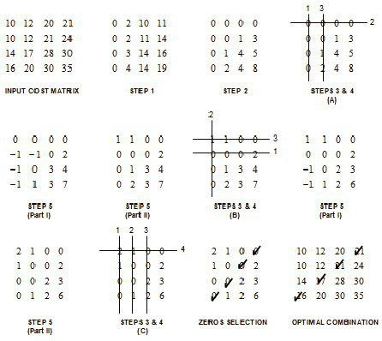
Example for munkrs Assignment Algorithm

Slide 20
TWS Radar System Advantages
Scan and Track on same system
Tracking information used for computation of a fire control solution.
Immediate Fire Control Solution
Notes:
Stress the following:
a. Search radar searches and identifies contacts (uses previous sweep’s information to determine if each return is that of a contact that is being tracked or is a new contact).
b. Only when going to use a weapons system is a fire control radar and launcher system assigned. The target’s position and track information
is then shared from the tracking computer.
c. This allows continuous track on targets but receives the fine tuning of the target of interest’s parameters to the Automatic tracking system of the angle-tracking servo, feedback enhanced for fire control radar.

Slide 21
Conclusion and Discussion
The focus of this paper has been to answer the question,
What functions should a TWS system perform in order to combine the search and tracking tasks into one integrated unit?
The functions of (1) target detection, (2) target track correlation and association, (3) track initiation and track file generation, (4) generation of tracking "gates," (5) track gate prediction, smoothing (filtering), and positioning, (6) display and future target position calculations were explained as well as was an explanation of the - filter.

Slide 22
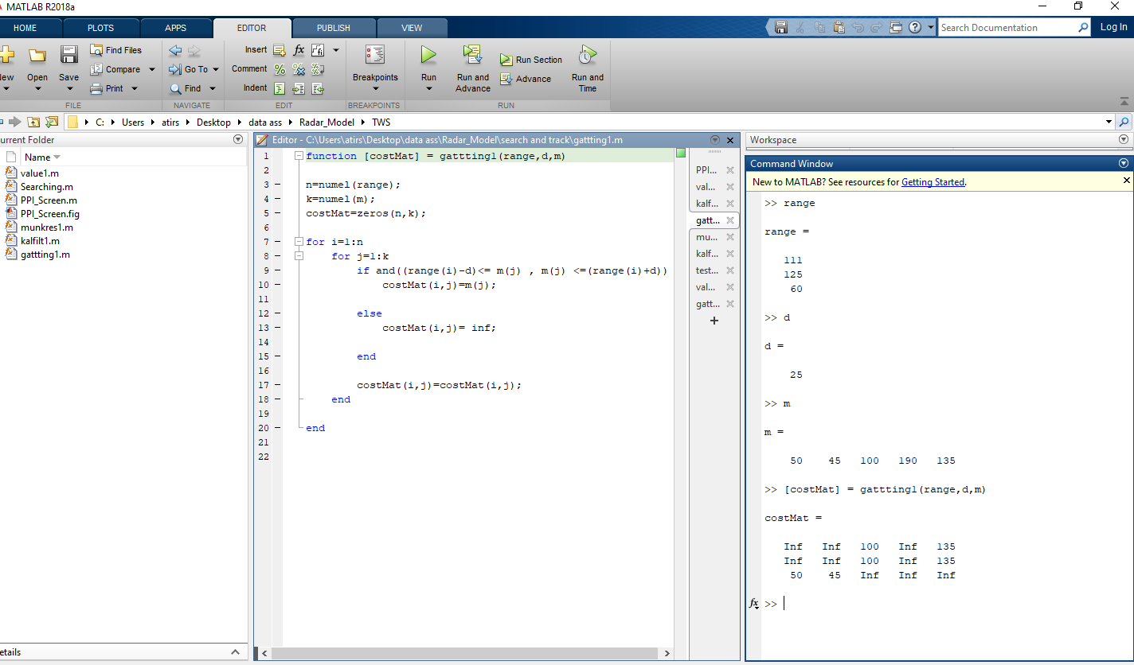

Slide 23
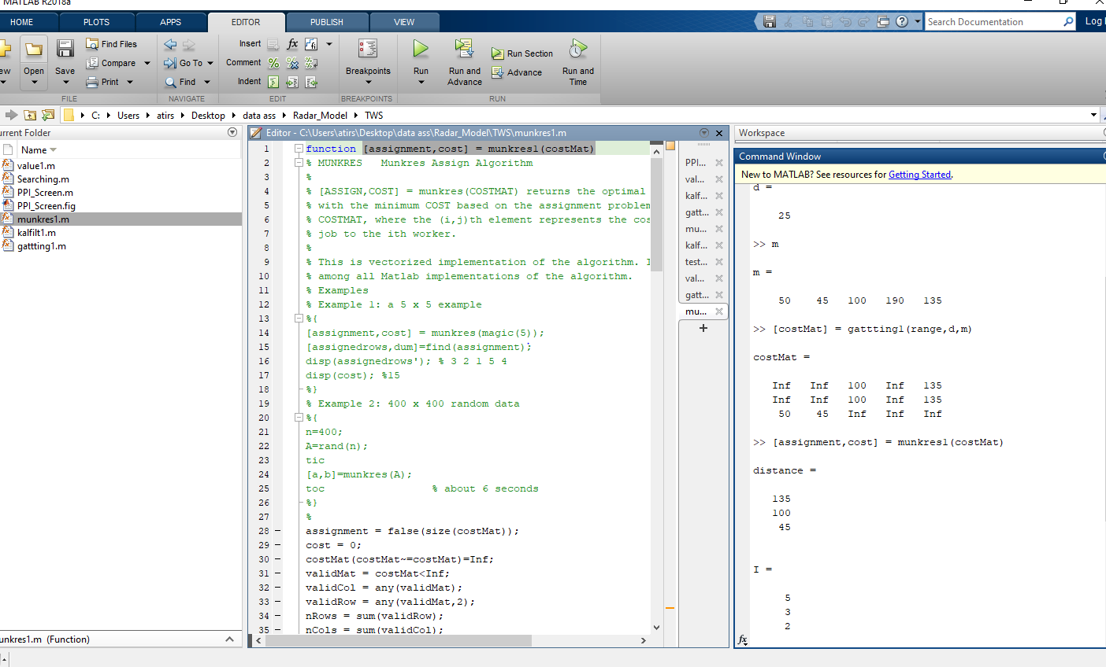

Slide 24
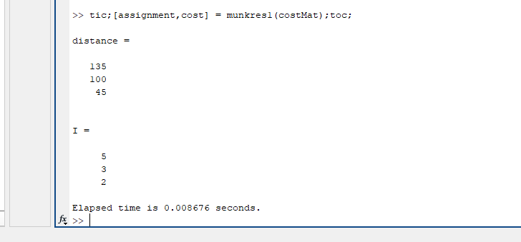

Slide 25
Summary
Radar continues scanning
Computer predicts positions
Track while Scan!
Track information used for fire control solution.

